Slide 1
Mass Media Laws

Slide 2
DEFAMATION
Section 499 of IPC: Whoever, by words either spoken or intended to be read, or by signs or by visible representations, makes or publishes any imputation concerning any person intending to harm, or knowing or having reason to believe that such imputation will harm, the reputation of such person, is said, except in the cases hereinafter expected, to defame that person.

Slide 3
Types of defamation
Under English law, it is of two types
Libel and Slander
Libel is a representation made in a permanent form which means it must be published whether through writing, printing, picture, statue etc.
Slander is a representation made in oral or transit form e.g. by spoken words or gestures.

Slide 4
Elements of defamation
The presence of defamatory content is required.
Defamatory content is defined as one calculated to injure the reputation of another by exposing him to hatred, contempt or ridicule.
However, the test for such content is the ordinary man test where meaning of the content is considered to be what a common, ordinary man will comprehend it to be.
The claimant should be identified in the defamatory statement.
There must be a publication of the defamatory statement in either oral or written form. Unless the content is published – made available to someone other than the claimant, it cannot be called as defamation.

Slide 5
Defamation Law (Section 499)
Explanation 1 - It may amount to defamation to impute anything to a deceased person, if the imputation would harm the reputation of that person if living, and is intended to be hurtful to the feelings of his family or other near relatives.
Explanation 2 - It may amount to defamation to make an imputation concerning a company or an association or collection of persons as such.
Explanation 3 -An imputation in the form of an alternative or expressed ironically, may amount to defamation.

Slide 6
Defamation Law (Section 499)
Explanation 4.—No imputation is said to harm a person’s reputation, unless that imputation directly or indirectly, in the estimation of others, lowers the moral or intellectual character of that person, or lowers the character of that person in respect of his caste or of his calling, or lowers the credit of that person, or causes it to be believed that the body of that person is in a loathsome state, or in a state generally considered as disgraceful.

Slide 7
Exceptions
Imputation of truth, public good, requires to be published
Public conduct of public servant
Any opinion in respect of conduct of public servant in discharge of public function
Conduct of any person touching any public action
Publication of report of proceedings of the court merits of the case decided in court or conduct of witnesses and others concerned
Express in good faith in your opinion
Conduct of any party is witness or agent respecting the character of such persons and no further
Merits of public performance
Censure passed in good faith by a person having lawful authority over others
Accusation preferred in good faith to authorised person
Imputation made in good faith by a person to protect his or other’s interest
Caution intended for good of person to whom conveyed or for public good

Slide 8
Section 500 of IPC
Punishment for defamation.—Whoever defames another shall be punished with simple imprisonment for a term which may extend to two years, or with fine, or with both.

Slide 9
Invasion of privacy

Slide 10
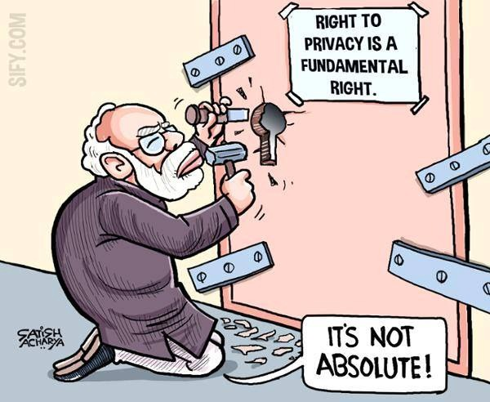
The right to be left alone.
Invasion of privacy is the unjustifiable intrusion into the personal life of another without consent.
Right to privacy is a requisite of right to life and personal liberty under Article 21 of the Indian Constitution
Right to Privacy - A Fundamental Right
Not an Absolute Right - Subject to Reasonable Restrictions
Interpreted using Article 19 (Freedom) and 21(Life and liberty) of the Indian constitution

Slide 11
Types of invasion of privacy
The four most common types of invasion of privacy torts are as follows:
Appropriation of Name or Likeness
Intrusion Upon Seclusion
False Light
Public Disclosure of Private Facts

Slide 12
Appropriation of Name or Likeness
Right to control the use of your own identity for a business or economic purpose
Claims involve the unauthorized use of a person's picture or name
Elements necessary to prove appropriation:
The defendant (the party being sued) used the plaintiff's (the party initiating the lawsuit) name, likeness or identity;
The use was for the defendant's benefit, whether the benefit is economic or otherwise
The use was without the plaintiff's consent
The use caused injury to the plaintiff.

Slide 13
Intrusion Upon Seclusion
Intrusion upon seclusion laws protect your right to privacy while you are in solitude or seclusion
The general elements of this tort are as follows:
The defendant intruded into the plaintiff's private affairs, seclusion or solitude
The intrusion would be objectionable to a reasonable person
Defendant does not need to communicate the details of the intrusion to a third party; once the defendant has committed the intruding act, the defendant is liable for invasion of privacy.

Slide 14
False Light
False light laws protect your right to not have potentially misleading or damaging information about yourself publicly disclosed
This includes the disclosure of information that may be true but is nonetheless misleading or damaging
Elements of false light are as follows:
The defendant publicly disclosed information about the plaintiff
The information placed the plaintiff in a false light
The false light would be highly offensive to a reasonable person.

Slide 15
Public Disclosure of Private Facts
Public disclosure of private facts laws protect your right to keep the details of your private life from becoming public information
Publicizing facts about a person's health, sexual conduct, or financial troubles is likely an invasion of privacy
The general elements of this tort are as follows:
The defendant publicized a matter regarding the private life of the plaintiff;
The publicized matter would be highly offensive to a reasonable person; and
It is not of legitimate concern to the public.
Private information is disseminated in such a way that it is substantially certain to become public knowledge.

Slide 16
International conventions
Universal Declaration of Human Rights:
The Declaration was proclaimed by the United Nations General Assembly in Paris on 10 December 1948 (General Assembly resolution 217 A) as a common standard of achievements for all people and all nations. Article 12: No one shall be subjected to arbitrary interference with his privacy, family, home or correspondence, nor to attacks upon his honour and reputation. Everyone has the right to the protection of the law against such interference or attacks.
Article 17 of the International Covenant on Civil and Political Rights(ICCPR) states: No one shall be subjected to arbitrary or unlawful interference with his privacy, family, home or correspondence, nor to unlawful attacks on his honour and reputation.

Slide 17
India and right to privacy
Exceptions to the rule of privacy
The RTI Act, makes an exception under section 8 (1) (j), which exempts disclosure of any personal information which is not connected to any public activity or of public interest or which would cause an unwarranted invasion of privacy of an individual
What constitutes an unwarranted invasion of privacy is not defined

Slide 18
In case of a representative of the public, such as a public person, the right to privacy afforded to them is not of the same degree as that to a private person.
A private citizen's privacy right is undoubtedly of the same nature and character as that of a public servant. Therefore, it would be wrong to assume that the substantive rights of the two differ. Yet, inherent in the situation of the latter is the premise that he acts for the public good, in the discharge of his duties, and is accountable for them. The character of protection, therefore, afforded to the two classes — public servants and private individuals, is to be viewed from this perspective. The nature of restriction on the right to privacy is therefore, of a different order; in the case of private individuals, the degree of protection afforded is greater; in the case of public servants, the degree of protection can be lower, depending on what is at stake.

Slide 19
The Press Council of India (PCI) has laid down Norms of Journalistic Conduct, which address the issue of privacy.
The PCI Norms of Journalistic Conduct, recognises privacy as an inviolable human right, but adds a caveat; that the degree of privacy depends on circumstances and the person concerned.
In testing whether certain information falls within the purview of the RTI Act, the court said one should consider the following three tests:
whether the disclosure of the personal information is with the aim of providing knowledge of the proper performance of the duties and tasks assigned to the public servant in any specific case;
whether the information is deemed to comprise the individual's private details, unrelated to his position in the organization, and,
whether the disclosure will furnish any information required to establish accountability or transparency in the use of public resources.
The tests delineated by the court in considering what personal information regarding a public authority may be shared under the RTI Act, can be adopted by the media when reporting on public officials. If personal information divulged by the media does not shed light on the performance of a public official, which would be of public interest, then the information revealed violates the standards of privacy. Personal details which have no bearing on public resources or interests should not be published.

Slide 20
The PCI Norms reiterate that the media should not intrude "the privacy of an individual, unless outweighed by genuine overriding public interest, not being a prurient or morbid curiosity.“
The well accepted rule, however, is that once a matter or information comes in the public domain, it no longer falls within the sphere of the private.
The media has failed to make the distinction between what is warranted invasion of privacy and what constitutes as an unwarranted invasion of privacy.

Slide 21
Section 228A of the Indian Penal Code makes disclosure of the identity of a rape victim punishable
The PCI warns journalists not to give excessive publicity to victims, witnesses, suspects and accused as that amounts to invasion of privacy.
Identification of witnesses may endanger the lives of witnesses and force them to turn hostile.

Slide 22
CRC
Convention on the Rights of the Child (CRC) stipulates that:
Article 16
No child shall be subjected to arbitrary or unlawful interference with his or her privacy, family, or correspondence, nor to unlawful attacks on his or her honour and reputation.
The child has the right to the protection of the law against such interference or attacks.

Slide 23
Sting operations
Guidelines direct a channel proposing to telecast a sting operation to obtain a certificate from the person who recorded or produced the same certifying that the operation is genuine to his knowledge.
The guidelines propose that the Ministry of Information and Broadcasting should set up a committee which would have the powers to grant permission for telecasting sting operations.
The permission to telecast a sting operation should be granted by the committee only if it is satisfied about the overriding public interest to telecast the sting operation.
The guidelines mandate that, in addition, to ensuring accuracy, the operation should not violate a person’s right to privacy, "unless there is an identifiable large public interest” for broadcasting or publishing the material. However, the court failed to define what constitutes 'larger public interest'.
The PCI norms also lay down similar guidelines which require a newspaper reporting a sting operation to obtain a certificate from the person involved in the sting to certify that the operation is genuine and record in writing the various stages of the sting.

Slide 24
Section 5 of the Cable Television Networks (Regulation) Act, 1995 and the Cable Television Network Rules (hereafter the Cable Television Networks Act), stipulates that no programme can be transmitted or retransmitted on any cable service which contains anything obscene, defamatory, deliberate, false and suggestive innuendos and half truths. The Rules prescribes a programming code to be followed by channels responsible for transmission/re-transmission of any programme.

Slide 25
Conclusion
The right to privacy in India has failed to acquire the status of an absolute right.
The Indian norms or code of ethics in journalism fail to make such a distinction between public and private space.
Nor do the guidelines impose any restrictions on photographing an individual without seeking express consent of the individual.
The Indian media violates privacy in day-to-day reporting, like overlooking the issue of privacy to satisfy morbid curiosity
In India, the right to privacy is not a positive right
It comes into effect only in the event of a violation
The prevalent right to privacy is easily compromised for other competing rights of ‘public good’, ‘public interest’ and ‘State security’, much of what constitutes public interest or what is private is left to the discretion of the media

Slide 26
Copyright Act, 1957

Slide 27
Copyright is the set of exclusive rights granted to the author or creator of an original work, including the right to copy, distribute and adapt the work.
Copyright ensures certain minimum safeguards of the rights of authors over their creations, thereby protecting and rewarding creativity.
The main Intellectual Property Rights legislation related to media sector is the Copyright Act of 1957 and Copyright Rules, 1958 and the International Copyright Order, 1999

Slide 28
Meaning of copyright
According to Section 14 of the Act, “copyright” means “the exclusive right subject to the provisions of this Act, to do or authorise the doing of any of the following acts in respect of a work or any substantial part thereof
(a) in the case of a literary, dramatic or musical work, not being a computer programme,
(i) to reproduce the work in any material form including the storing of it in any medium by electronic means
(ii) to issue copies of the work to the public not being copies already in circulation
(iii) to perform the work in public, or communicate it to the public
(iv) to make any cinematograph film or sound recording in respect of the work
(v) to make any translation of the work
(vi) to make any adaptation of the work
(vii) to do, in relation to a translation or an adaptation of the work, any of the acts specified in relation to the work in sub-clauses (i) to (vi)

Slide 29
(b)in the case of a computer programme,
(i) to do any of the acts specified in clause (a)
(ii) to sell or give on commercial rental or offer for sale or for commercial rental any copy of the computer programme: Provided that such commercial rental does not apply in respect of computer programmes where the programme itself is not the essential object of the rental.

Slide 30
(c) in the case of an artistic work
(i) to reproduce the work in any material form including depiction in three dimensions of a two dimensional work or in two dimensions of a three dimensional work
(ii) to communicate the work to the public
(iii) to issue copies of the work to the public not being copies already in circulation
(iv) to include the work in any cinematograph film
(v) to make any adaptation of the work
(vi) to do in relation to an adaptation of the work any of the acts specified in relation to the work in sub-clauses (i) to (iv);

Slide 31
(d) In the case of cinematograph film
(i) to make a copy of the film, including a photograph of any image forming part thereof
(ii) to sell or give on hire, or offer for sale or hire, any copy of the film, regardless of whether such copy has been sold or given on hire on earlier occasions
(iii) to communicate the film to the public

Slide 32
(e) In the case of sound recording
(i) to make any other sound recording embodying it
(ii) to sell or give on hire, or offer for sale or hire, any copy of the sound recording regardless of whether such copy has been sold or given on hire on earlier occasions
(iii) to communicate the sound recording to the public.

Slide 33
Classes of works for which copyright protection is available
1. Original Literary Work
2. Original Dramatic Work
3. Original Musical Work
4. Original Artistic Work
5. Cinematograph Films
6. Sound recording
7. Computer Programme

Slide 34
Ownership of copyright
The author of the work will be the first owner of the copyright except in the following instances:
i. In the case of a literary, dramatic or artistic work made by the author in the course of his employment by the proprietor of a newspaper, magazine or similar periodical under a contract of service or apprenticeship, for the purpose of publication in a newspaper, magazine or similar periodical, the said proprietor will, in the absence of any agreement to the contrary, be the first owner of the copyright in the work in so far as the copyright relates to the publication of the work in any newspaper, magazine or similar periodical, or to the reproduction of the work for the purpose of its being so published, but in all other respects the author will be the first owner of the copyright in the work.

Slide 35
Ownership of copyright
ii. In the case of a photograph taken, or a painting or portrait drawn, or an engraving or a cinematograph film made, for valuable consideration at the instance of any person, such person will, in the absence of any agreement to the contrary, be the first owner of the copyright therein.
iii. In the case of a work made in the course of the author’s employment under a contract of service or apprenticeship, the employer will, in the absence of any agreement to the contrary, be the first owner of the copyright therein.
iv. In the case of any address or speech delivered in public, the person who has delivered such address or speech or if such person has delivered such address or speech on behalf of any other person, such other person will be the first owner of the copyright therein notwithstanding that the person who delivers such address or speech, or, as the case may be, the person on whose behalf such address or speech is delivered, is employed by any other person who arranges such address or speech or on whose behalf or premises such address or speech is delivered.

Slide 36
Ownership of copyright
v. In the case of a government work, government in the absence of any agreement to the contrary, will be the first owner of the copyright therein.
vi. In the case of a work made or first published by or under the direction or control of any public undertaking, such public undertaking in the absence of any agreement to the contrary, will be the first owner of the copyright therein.
vii. In case of any work which is made or first published by or under the directions or control of any international organisation, such international organisation will be the first owner of the copyright therein.

Slide 37
Term of copyright
Copyright generally lasts for a period of sixty years.
In the case of literary, dramatic, musical or artistic works, the sixty year period is counted from the year following the death of the author.
In the case of cinematograph films, sound recordings, photographs, posthumous publications, anonymous and pseudonymous publications, works of government and public undertakings and works of international organisations, the 60-year period is counted from the date of publication.
In case of Broadcast reproduction right - 25 years from the beginning of the calendar year next following the year in which the broadcast is made.
In case of Performers right - 25 years from the beginning of the calendar year next following the year in which the performance is made.

Slide 38
Digital piracy

Slide 39
Meaning
Piracy means unauthorised reproduction, importing or reproduction of the whole or any part of work protected by copyright.
Online/ Digital piracy is the term to describe the illegal act of duplication of licensed or copyright material from internet. There are three main piracy context- music, movie and software. Audio books and other copyrighted material is also covered under digital piracy.
Piracy is not a theft.

Slide 40
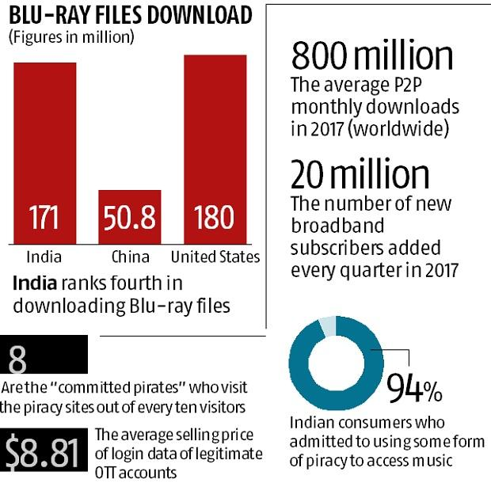
Digital piracy in India
Indians form the largest group to download Indian copyright content from torrent sites
Delhi, Mumbai and Bangalore accounted for maximum level of illegal downloading.
Downloading any protected content from torrents, be it a simple video, song or a movie, amounts to copyright violation of the owner.

Slide 41
Copyright (Amendment), Act 2012
The Copyright (Amendment) Act, 2012 has amended piracy laws in India.
One of its main objectives was to curb digital piracy.
WIPO – World Intellectual Property Organisation
To facilitate the membership of India in WIPO Copyright Treaty (WCT) and the WIPO Performers and Phonograms Treaty (WPPT)
Section 65(A) and Section 65(B) was inserted in the act.

Slide 42
Section 65(A)
Section 65(A) was provided for the Protection of Technological Measures.
It states that any person who circumvents an effective technological measure applied for protecting any of the rights conferred in the Act, with the intention of infringing such rights, shall be punishable with imprisonment which may extend to two years and shall also be liable to fine.

Slide 43
Section 65 (B)
Section 65(B) was provided for the Protection of Rights Management Information.
It states that any person, who knowingly- (1) removes or alters any rights management information without authority, or (2) distributes, imports for distribution, broadcasts or communicates to the public, without authority, copies of any work, or performance knowing that electronic rights management information has been removed or altered without authority, shall be punishable with imprisonment which may extend to two years and shall also be liable to fine.

Slide 44
Other major changes as per 2012 amendment

Slide 45
John Doe orders/ Ashok Kumar orders
The term John Doe order refers to orders where the identities of defendants are unknown at the time of filing of the petition and the orders identify the defendants only by way of some description.
In India, John Doe orders are also called as Ashok Kumar orders.
Producers of the Indian Film Industry are using these orders to deal with the problem of online piracy.
By this order, any suspected website can be blocked before the release of new movies.
These orders are granted only after careful investigation of the circumstances.
In India, this order is mostly related to pirating of movies, illegal broadcasting of channels, and illegal publishing of books, among others.

Slide 46
John Doe Order and Indian Courts
Under the Indian scenario, John Doe order is issued in the following areas:
Movies
Before release or even after release, the telecasting or copying and selling unauthorized copies of a movie. The producers can protect their rights by securing a John Doe order where the will file a petition/application to issue John Doe order in the name of so-called produced movie by them and the court may upon deciding the merits of the case may proceed to issue John Doe order.
Books
Author or the Publisher may approach the court and establish that the book authored by them is having a likely apprehension of copying without the permission of the author or the publisher and therefore, should be curbed by such unauthorized publication. The court may upon evaluation of the case grant the John Doe order.
Sports Events
Live telecast rights can be protected via John Doe order.

